Slide 1
Random Forest Model
Notes:
1

Slide 2
Introduction
Random Forest (or random forests) is an ensemble classifier that consists of many decision trees and outputs the class that is the mode of the class's output by individual trees.
The term came from random decision forests that was first proposed by Tin Kam Ho of Bell Labs in 1995.
The method combines Breiman's "Bagging" idea and the random selection of features.
Notes:
2

Slide 3
Introduction
Ensembling is usually done using the concept of bagging with different feature sets.
The reason for using large number of trees in random forest is to train the trees enough such that contribution from each feature comes in a number of models.
After the Random Forest is generated by combining the trees,majority vote is applied to combine the output of different trees.
The result from the Ensemble model is usually better than that from the individual decision tree models.
Notes:
3

Slide 4
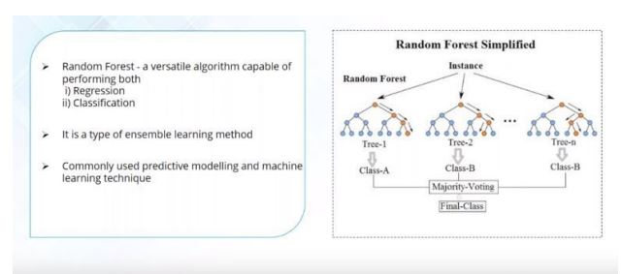
Random Forest Model
Notes:
4

Slide 5
How does Random Forest works:
If there are N variables or features in the input dataset,select a subset of ‘m’ (m < N)features out of the N features.Also,the observations or data instances should be picked randomly.
Use the best split principle on these ‘m’ features to calculate the number of nodes ‘d’.
Keep splitting the nodes to child nodes till the tree is grown to the maximum possible extent.
Select a different subset of training data ‘with replacement’ to train another decision tree following steps (1) to (3) .Repeat this to build and train ‘n’ decision trees.
Final class assignment is done on the basis of the majority votes from the ‘n’ trees.
Notes:
5

Slide 6
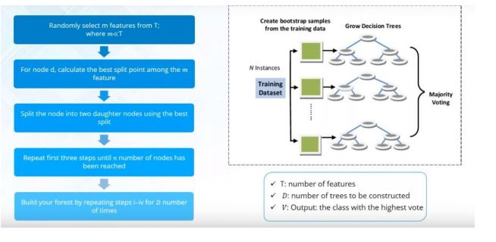
How does Random Forest works:
ssasasas
Notes:
6
T is the total number of predictive variables we select few features out of it only make our model to learn something new,as we select randomly variables,as every time we get a new decision tree as it gets variety of experiences,to get more accurate result.

Slide 7
Practical Consideration
Splits are chosen according to a purity measure:
E.g. Squared error (regression), Gini index or Entropy (classification)
Gini Index is the measure of how often a randomly chosen element from the set would be incorrectly labeled if it was randomly labeled according to the distribution of labels in the subset.
Gini(E) = 1 - Σj = 1 to c p^2 j (Sum of outcomes in the event)
Notes:
7

Slide 8
Practical Consideration
How to select N (variables or features) ?
Build trees until the error no longer decreases
How to select m ?
Try to recommend defaults, half of them and twice of them and pick the best.
If the number of trees is assumed to be excessively large.the model may get overfitted.In an extreme case of overfitting the model may mimic training data,and training error might be zero.
Notes:
8

Slide 9
Features and Advantages
It is one of the most accurate learning algorithms available. For many data sets, it produces a highly accurate classifier.
It runs efficiently on large databases.
It can handle thousands of input variables without variable deletion.
It gives estimates of what variables are important in the classification.
It generates an internal unbiased estimate of the generalization error as the forest building progresses.
It has an effective method for estimating missing data and maintains accuracy when a large proportion of the data are missing.
Notes:
9

Slide 10
Advantages
It has methods for balancing error in class population unbalanced data sets.
Generated forests can be saved for future use on other data.
Prototypes are computed that give information about the relation between the variables and the classification.
It computes proximities between pairs of cases that can be used in clustering, locating outliers, or (by scaling) give interesting views of the data.
The capabilities of the above can be extended to unlabeled data, leading to unsupervised clustering, data views and outlier detection.
It offers an experimental method for detecting variable interactions.
Notes:
10

Slide 11
Disadvantages
Random forests have been observed to overfit for some datasets with noisy classification/regression tasks.
For data including categorical variables with different number of levels, random forests are biased in favor of those attributes with more levels. Therefore, the variable importance scores from random forest are not reliable for this type of data.
It is also computationally much more expensive than a simple model like Decision Tree.
Notes:
11

Slide 12
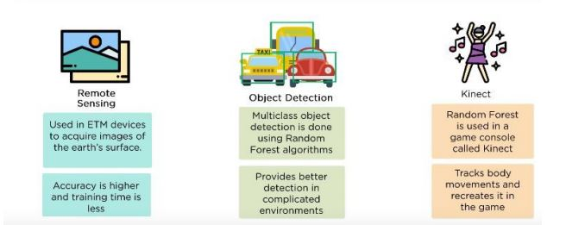
Applications
Notes:
12

